Slide 1
10.3 Nonlinear Multi-Output Regression

Slide 2
Modeling principles

Slide 3
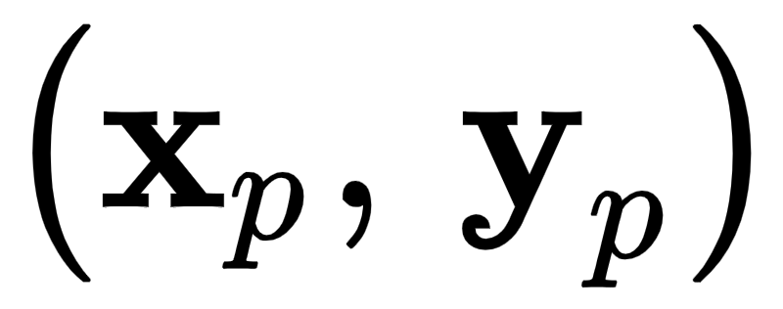


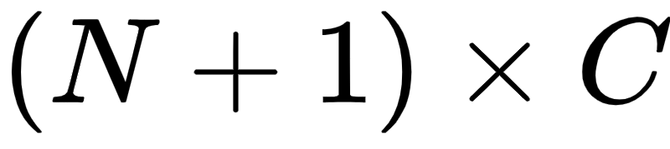
Recall when dealing with linear multi-output regression, we have N dimensional input / C dimensional output pairs , and our joint linear model for all C regressions takes the form
Here the weight matrix has dimension .

Slide 4
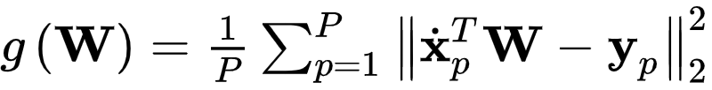
We can tune the parameters of this joint model *one column at a time* by solving each linear regression *independently*.
We can also tune the parameters of *simultaneously* by minimizing an appropriate regression cost function over the entire matrix, e.g., the Least Square
However because this model is *linear* the results of either approach result in the same tuning of the parameters.

Slide 5
With multi-output regression the move from linear to nonlinear modeling mirrors what we have seen previously -- with one small but important wrinkle.
With C regressions to perform we can choose to either produce C *independent* nonlinear models or one *shared* nonlinear model for all C regressions.

Slide 6
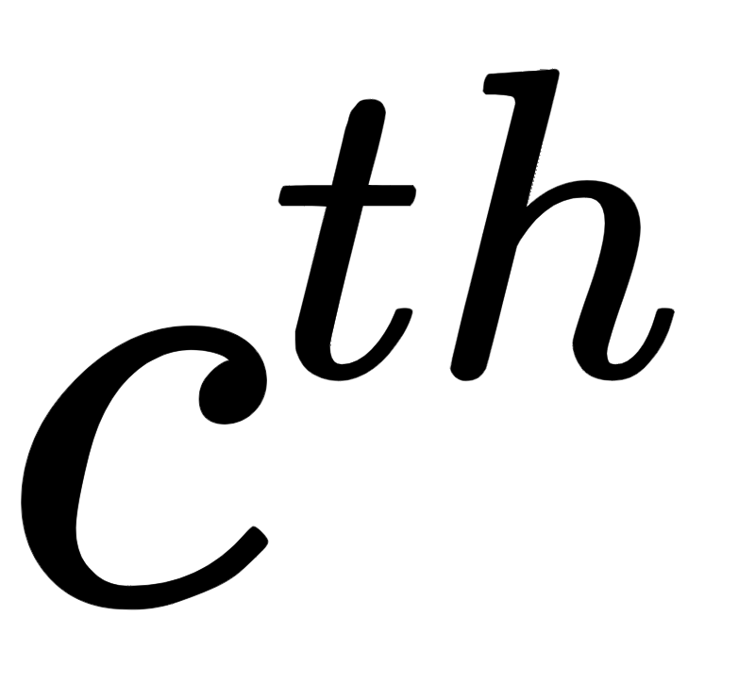
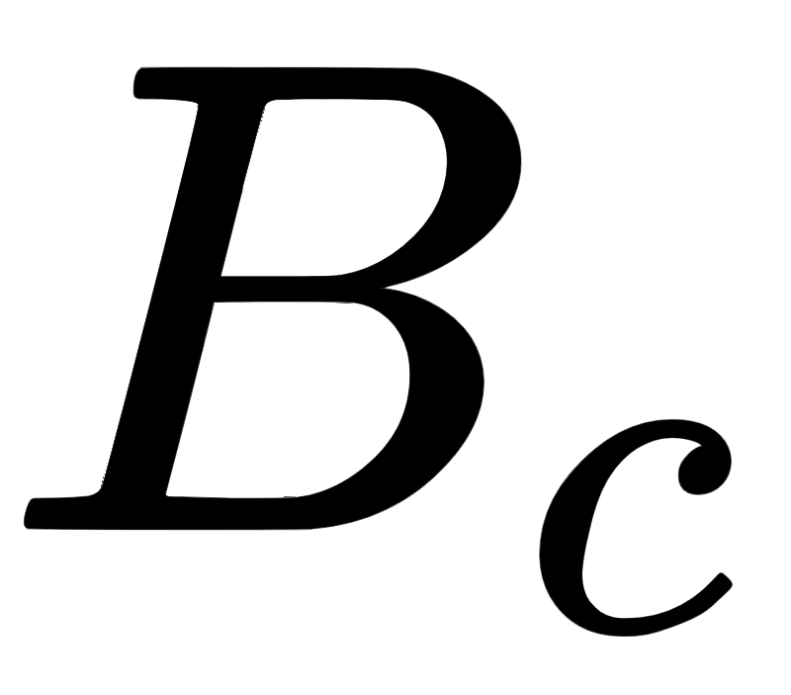
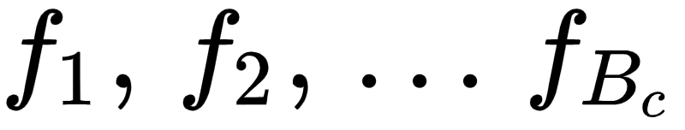
The independent approach
If we choose the independent approach - forming C separate nonlinear models - each feature engineering / nonlinear regression is executed precisely as we have seen previously.
That is, for the regression problem we construct a model using (in general) nonlinear feature transformations as
Here are nonlinear parameterized or unparameterized functions that can be chosen uniquely for the model.

Slide 7
The feature-sharing approach
With the feature-sharing approach to nonlinear multi-output regression we simply use the same nonlinear features for all C models.
This is very often done to simplify the chores of nonlinear feature engineering.
If we choose the same set of B nonlinear features for all C models the of which looks like

Slide 8
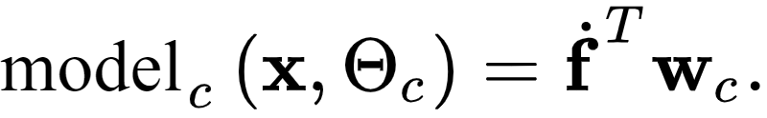
Employing the same compact notation for our feature transformations as introduced previously we can express each of these models more compactly as

Slide 9
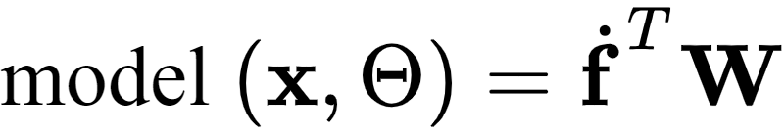
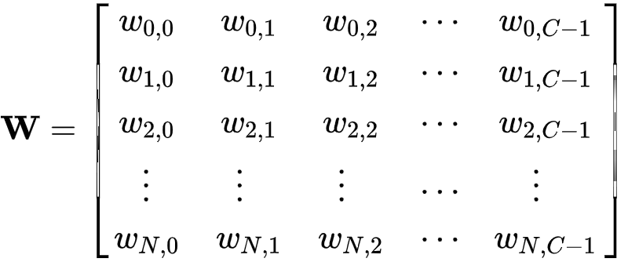
Alternatively we can formulate all C models together in one model by stacking the linear combination weights from our C nonlinear models into an array of the form

Slide 10

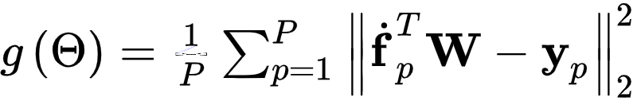
Note here that the set contains the linear combination weights as well as any parameters internal to our feature transformations.
To tune the weights of our joint model we minimize an appropriate regression cost over the parameters in , e.g., the Least Squares

Slide 11
If feature transformations used contain *no internal parameters*, e.g., if they are polynomial functions, then each of the C individual regression models can be tuned separately.
Otherwise when employing *parameterized* features (e.g., neural networks) we must tune all of our model parameters *jointly*, that is learn all C regressions *simultaneously*.

Slide 12
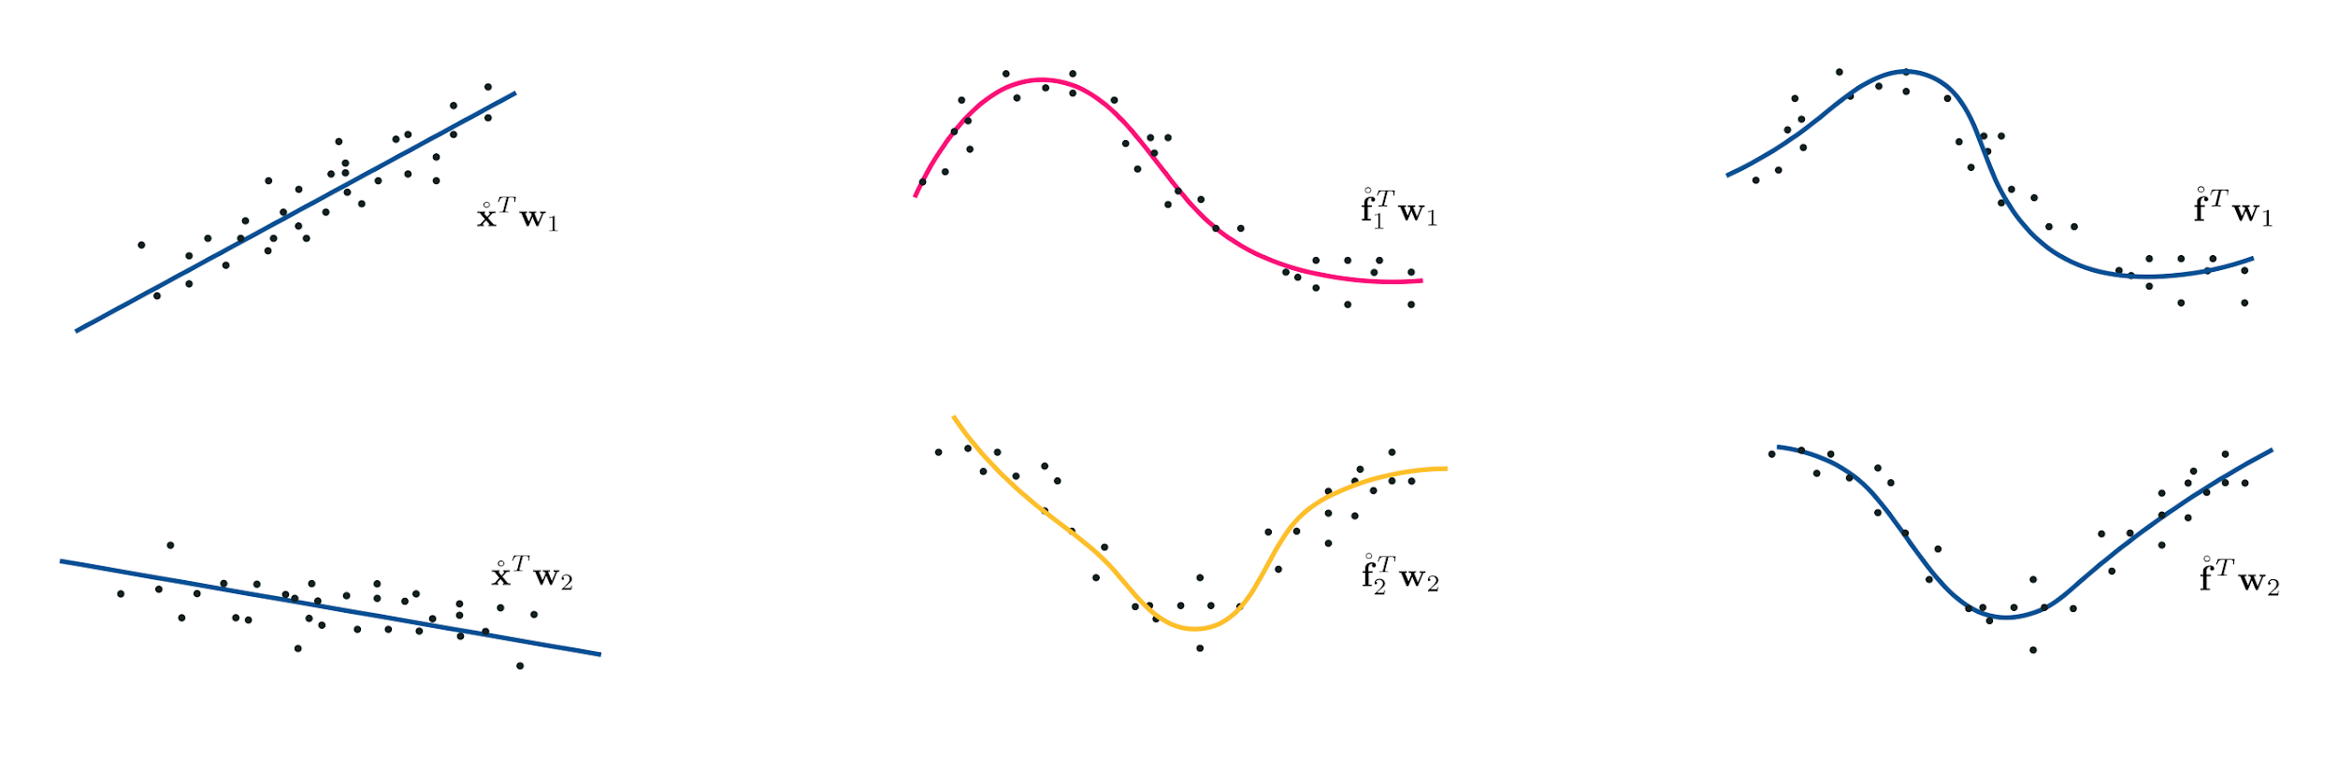
(left) Linear multi-output regression. (middle) Nonlinear multi-output regression: the independent scheme. (right) Nonlinear multi-output regression: the feature-sharing scheme.

Slide 13
Feature engineering

Slide 14
Example: Tuning multiple regressions simultaneously

Slide 15
Below we show a C = 2 multi-ouptput regression dataset, the first pairs are shown in the left panel while the second pairs are shown in the right.
Both instances appear to be sinusoidal in nature, with each having its own unique shape.

Slide 16
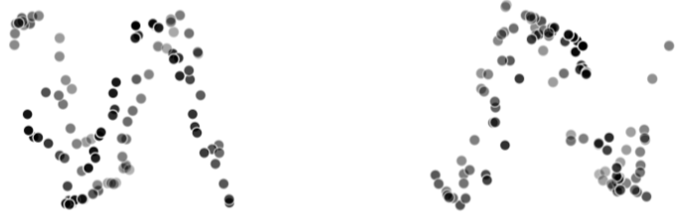

Slide 17
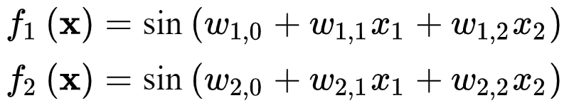
To model both regressions simultaneously we will use B = 2 parameterized sinusoidal feature transformations
Fitting this set of nonlinear features jointly to both regression problems above (using gradient descent) results in the fits shown below.

Slide 18
